Slide 1
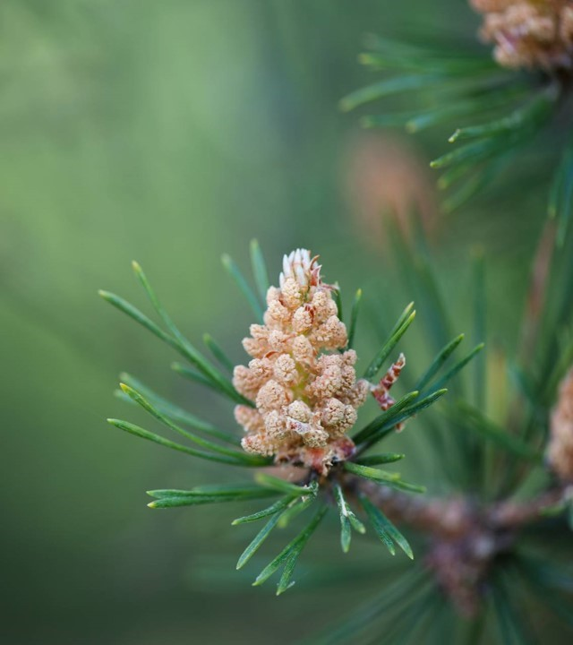
Using LangChain and Gemma Models to develop faster AI agents on edge
Supriya Sirbi, Aptiv

Slide 2
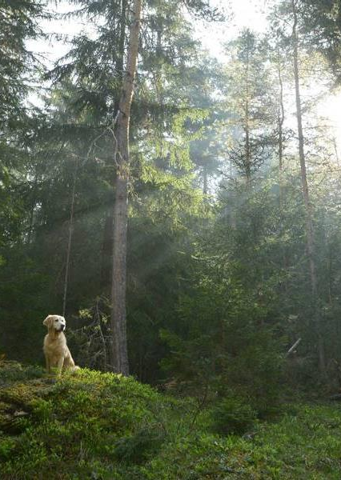
AGENDA
1. Introduction to LangChain 2. LangChain, LangGraph, LangSmith and Deep Agents 3. LangChain Agent on Edge with Gemma 4. Summary
5. Demo 6. Resources

Slide 3

LanGCHAIN
LangChain is an open-source framework with a pre-built agent architecture and integrations for any model or tool — so you can build agents that adapt as fast as the ecosystem evolves
Advantages of LangChain
Standard Model Interface
Easy to use, Flexible Agent
Built on Top of LangGraph
Debug Support with LangSmith

Slide 4
LangChain vs. LangGraph vs. Deep Agents VS. LANGSIMITH
LangChain - Simplest Way to Build Agents. If you don’t need these capabilities or would like to customize your own for your agents and autonomous applications, start with LangChain.
LangGraph - low-level agent orchestration framework and runtime, when you have more advanced needs that require a combination of deterministic and agentic workflows and heavy customization.
Deep Agents - comes with “batteries-included” and modern features like automatic compression of long conversations, a virtual filesystem, and subagent-spawning for managing and isolating context.
Deep Agents are implementations of LangChain Agents
LangSmith – An Observability Platform that gives you complete visibility into agent behavior.
Note: LangChain agents are built on top of LangGraph to provide durable execution, streaming, human-in-the-loop, persistence, and more.

Slide 5
LangChain Agent on Edge with Gemma
This application implements an AI-powered image understanding pipeline that combines the PaliGemma vision-language model with a LangChain agent framework to generate meaningful descriptions from uploaded images. When a user uploads an image, the system uses PaliGemma to produce an image caption and then applies a LangChain Agent Framework to generate a concise summary explaining the scene.
User Upload Image on edge Device
│
▼
Image Processing Layer
│
▼
PaliGemma Model
(Image Caption Generation)
│
▼
LangChain Agent with Tools
│
▼
Gemma Reasoning Model
│
▼
Structured Output
Caption + Scene Summary

Slide 6
Summary
LangChain Agent that creates a below pipeline
Accepts an image upload via Gradio
Tool 1 – Uses PaliGemma model to generate caption
Tool 2 - Uses an LLM chain to summarize / explain the caption with Gemma Model
Returns a final structured summary
User Upload
Image via Gradio
Create LangChain
Agent Pipline
PaliGemma
Image Captioning
Gemma LLM
Summarization
Gradio Output - Caption +
Scene Summary

Slide 7
DEMO

Slide 8
RESOURCES
LangChain Official Site - https://www.langchain.com/
LangChain Github Repo - https://github.com/langchain-ai/langchain
LangChain Academy - https://academy.langchain.com/
LangChain Docs - https://docs.langchain.com/

Slide 9
Thank you

